Slide 1

DOMESTIC VIOLENCE ACTION PLAN
Springvale Lions Baseball Club
2025/2026
Our Shared Goal: We want to create a respectful and safe environment where respect for each other is paramount, and inclusivity is at the forefront.
What a Safe & Strong Community Looks Like: People feel safe, equal and respected. Everyone has a place and feels safe and supported.
Our Commitment The Springvale Lions Baseball Club is committed to raising awareness and starting important conversations with EVERYONE. Not just men, not just women, everyone. We will not accept any incidence of family violence.

Slide 2



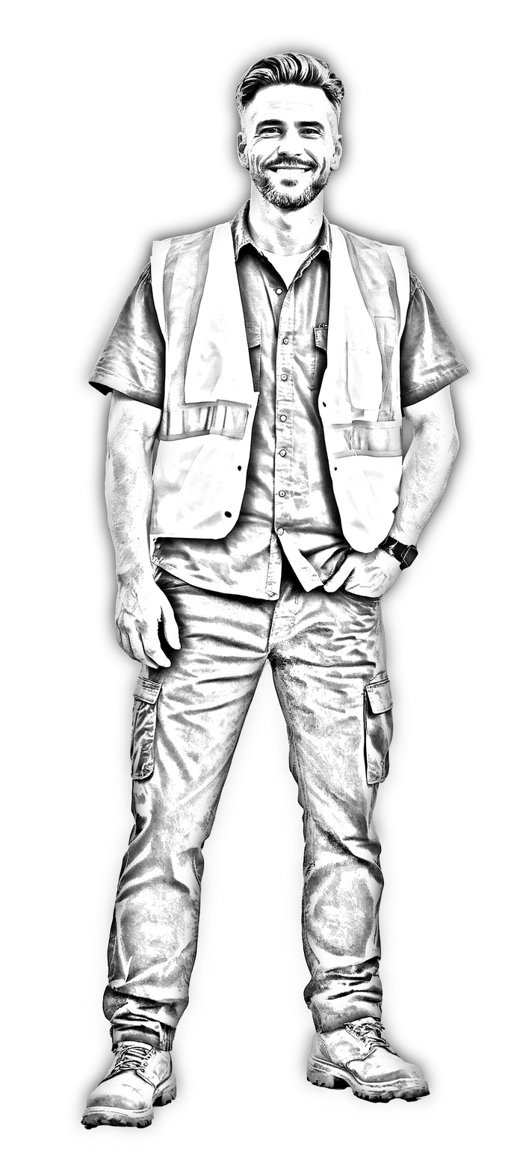

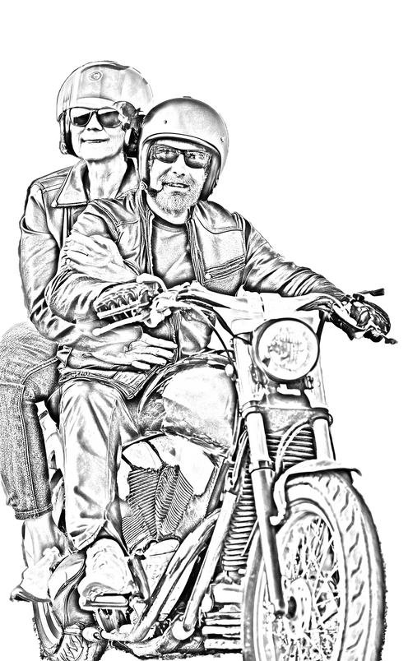
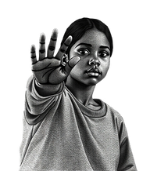
Action | Outcome | Time-Frame
1. Creating a link to NO MORE and relevant educational resources via our club website. | Expand knowledge and resources for members and their families | September 2025 and ongoing
2. Sharing printed NO MORE and other DFV resources and posting around the clubrooms and in high-traffic areas to raise awareness with both our own members and the opposition clubs each week. | Raise awareness through printed assets to spread the word | September 2025 and ongoing
3. Men’s program to wear NO MORE patches on uniforms throughout the season to create discussion, encourage open conversation and spread the word. | Create conversation and expand reach for NO MORE campaign overall | Full 2025/26 summer baseball season (October through March)
4. Creating a NO MORE themed club video to share via social media in order to help use our sport and members to share their thoughts, spread the word and reach a larger audience. | Help inspire not only our members but others, including men and women, plus help our younger members learn more about this important campaign | September 2025 and ongoing
5. Share social media posts/posters during the season (Facebook and Instagram) | Spread awareness | September 2025 and ongoing
TAKE THE STAND TODAY
90 LIVES.
90 DAYS.
90 PLANS.
WWW.THESTAND.ORG.AU

